Slide 1
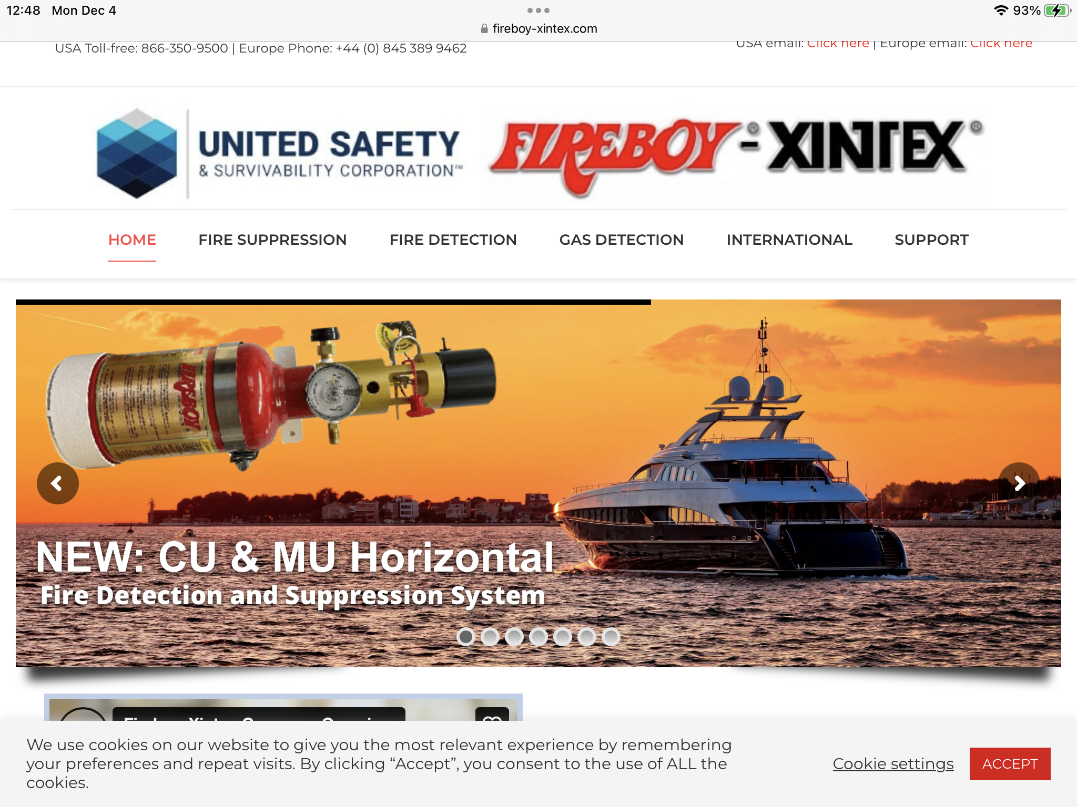
CCA SAFETY MINUTE
Installed fire suppression:
An Update
6 December 2023

Slide 2
LEGACY HALON SYSTEMS: STILL HAVE ONE?
HALON IS TOXIC. IF YOU GO INTO A CLOSED SPACE AFTER AN EXTINGUISHER HAS DISCHARGED, IT COULD BE FATAL.
HALON AND SOME OTHER AGENTS MAY LEAVE A MESS REQUIRING AN EXTENSIVE CLEANUP.
SOME FIRE FIGHTING AGENTS DESTROY ELECTRICAL COMPONENTS AND INTEGRATED CIRCUIT BOARDS.
HALON IS BAD FOR THE ENVIRONMENT.

Slide 3
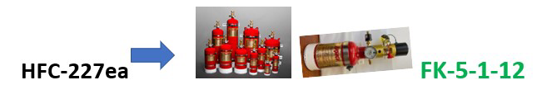
FIXED SYSTEMS USING NEW AGENTS ARE ON the HORIZON… Safer, with no oily residue or powder
FK-5-1-12 clean extinguishing agent will replace HFC-227ea in the near future!

Slide 4
Review what you have and what’s available
FK-5-1-12 does act differently than HFC-227ea when it is discharged so ALL current installations need to be reviewed for conversion to FK-5-1-12 to make sure it phase changes properly.
Some automatic extinguishers need to be mounted in the engine space vertically and others horizontally.
All new FK-5-1-12 installations need to be reviewed and approved – you cannot just drop the extinguisher in the old HFC-227ea location!

